Slide 1
RESEARCH METHODOLOGY
UNIT I

Slide 2
RESEARCH
Research is a logical and systematic search for new and useful information on a particular topic. It is an investigation of finding solutions to scientific and social problems through objective and systematic analysis. It is a search for knowledge, that is, a
discovery of hidden truths.

Slide 3
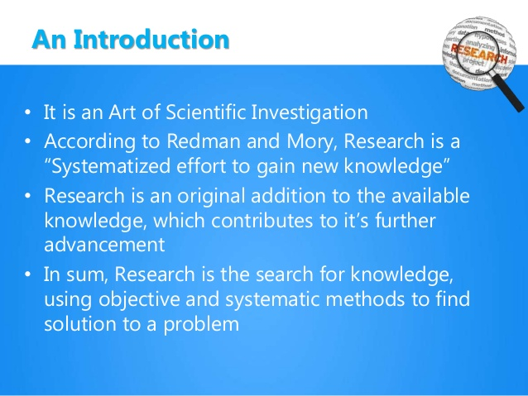

Slide 4
The word research is composed of two syllables, re and search.
re is a prefix meaning again, anew or over again
search is a verb meaning to examine closely and carefully, to test and try, or to probe. Together
they form a noun describing a careful, systematic, patient study and investigation in some field of
knowledge, undertaken to establish facts or principles.

Slide 5
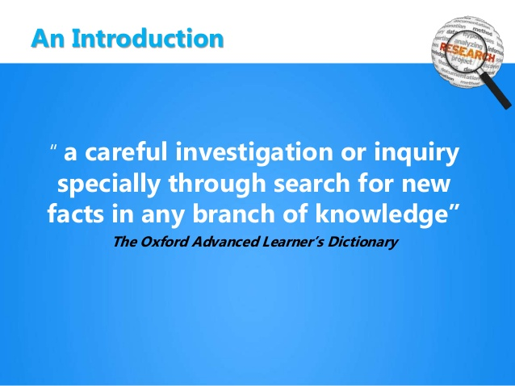

Slide 6
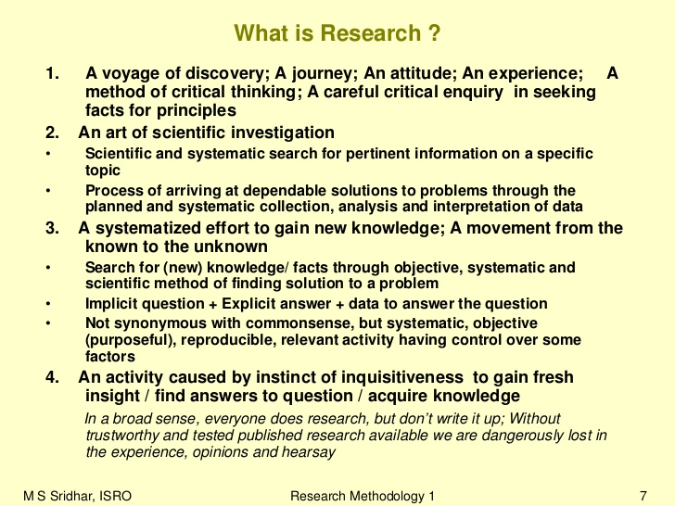

Slide 7
